Slide 1
Spectrum Pipeline Relocation Engineering Study (SPRES) and Follow-on
Presented to the Joint GRB-HRIT/EMWIN Users
Franz Zichy
Chief, Data Management and
Continuity of Operations Branch
03-15-2023

Slide 2
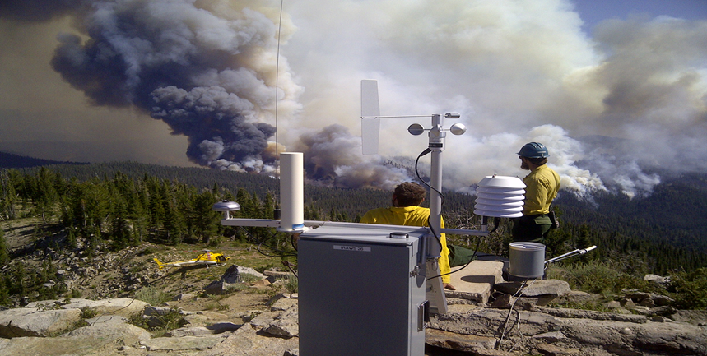
Introduction
2017 - NOAA Spectrum Pipeline Plan to apportion $12.03 million from the Spectrum Relocation Fund to NOAA
Conduct engineering study – sharing 1675-1680 MHz with mobile wireless service was feasible
Cost of the study will be recouped by the funds gained from the auction
Auction could occur within eight years.
Wildfire weather sensors send lifesaving data to GOES satellites

Slide 3
Spectrum Pipeline Study Scope and Objectives
Scope: The Spectrum Pipeline Reallocation Engineering Study (SPRES) assessed the potential for sharing the 1675-1680 MHz Meteorological Satellite (MetSat) band with commercial fixed and mobile wireless services nationwide while ensuring no impacts to NOAA and other federal user mission capabilities.
Objectives:
GOES Data Use
Map the flow of GOES data to users and applications
Determine the impact of loss or degradation of data
Derive MetSat user requirements for receiving the data transmitted in the 1675-1680 MHz band, and in the adjacent affected band
Radio Frequency Interference (RFI) Modalities and Risks
Characterize any RFI to GOES receivers and quantify the RFI risks
Mitigation Options and Feasibilities to Facilitate Sharing
Identify possible RFI mitigations
Assess the feasibility and effectiveness of these methods

Slide 4
L-Band Spectrum Allocations 50% of L-band MetSat Allocation is shared
US Table of Allocations
Meteorological-Satellite (space-to-earth)
1670-1710 MHz
1670-1710 MHz is allocated internationally in all three ITU Regions for Meteorological-Satellite (Space-Earth) use, known as Met-Sat downlinks. 1670-1700 MHz similarly allocated for Meteorological Aids (weather balloons).
Assignments in 1670-1690 MHz authorize NOAA to operate radiosondes. The frequency use has been reduced over time as Radiosondes transition out of the band, but transmissions will continue in the 1675-1683 MHz through 2023.
Assignments in 1673.4-1710 MHz authorize NOAA to operate Geostationary Operational Environmental Satellites (GOES) and polar-orbiting satellites to: 1) retrieve sensor data; 2) broadcast processed data; and 3) broadcast unprocessed instrument data (from polar satellites) to the meteorological community.
Shared
Proposed
Shared w/ AWS-3
Federal Allocation for Meteorological Satellites (Space-to-Earth)
1670
1675
1680
1685
1690
1695
1700
1705
1710 MHz
1670-1675 MHz
Auctioned 2003 to high power (downlink) Mobile/Fixed services (MS/FS). Shared between Ligado and MetSat Service
1695-1710 MHz
Auctioned 2015 to lower power (uplink) MS/FS services. Shared between AWS-3 and MetSat Service
1675-1680 MHz
Proposed for auction to share between MS/FS and MetSat Service

Slide 5
SPRES Project Dependencies
Project 4: Quantify cost and schedule for implementing alternative data distribution architectures
Alternative Architecture Analysis
Project 3: Identify and characterize alternative GOES data distribution architectures
Alternative Architectures
Project 1: Identify baseline GOES systems, user data flow and missions that could be impacted by interference and spectrum sharing
GeoXO Downlink Design Recommendations
RF Receiver Data &
User Data Flows
Project 5: Identify and characterize alternative GOES downlink designs
Project 2: Assess interference risks to downlink sites and the corresponding impact to users and missions
Project 10: Identify and evaluate interference monitoring approaches for ground stations
GOES Receive Site RFI Monitoring Approaches
Detailed Receive Site Characteristics
Site RFI Factors and Risks
Project 6: Identify and characterize ground station receiving equipment
Project 11: Assess interference risks and mitigations at downlink sites in the presence of LTE TDD signals
LTE TDD RFI Factors and Risks
Project 7: Determine the GOES interference protection criteria and associated sharing rules
GOES Receive Site Sharing Rules & RFI Mitigation Methods
Project 9: Evaluate and validate GOES-R receiver protection rules for spectrum sharing with AWS systems
GOES-R Receiver RFI Characteristics
Project 8: Characterize interference risks, protection rules, and mitigation techniques associated with anomalous propagation
Anomalous Propagation RFI Risks & Mitigations

Slide 6
SPRES Outcomes
The SPRES project flow resulted in four specific outcomes:
Evaluation of alternative data distribution architectures
DCS Administration and Data Distribution System (DADDS)
Alternative GOES downlink design recommendations
Combinations of various technologies that were leveraged to meet GeoXO requirements
GOES receive site RFI monitoring approaches
Items to consider: Sub-noise detection and classification, angle of arrival determination, aggregate RFI performance, real-time capabilities of monitoring system and notifications to wireless carriers
GOES downlink protection mechanisms and RFI mitigation methods
Protection mechanisms are location-specific
Sharing rules are driven by population density, commercial deployment type, severity of anomalous propagation, terrain effects

Slide 7
Refining the SPRES Analysis
SPRES-FO is initiated to refine the efforts of the SPRES projects
SPRES-FO report will propose solutions in the four main SPRES-FO tasks
Risk assessment analysis and risk impacts in outcomes of SPRES-FO
RFI modeling assumptions may impact sharing rules/protection criteria and assessments of alternative DCS facilities
RFI modeling assumptions will have different levels of impact based on the earth station location
Surface duct assumptions
Clutter modeling is location-specific
End-user outreach, degree of responses, and response time
Understanding end-user technical requirements

Slide 8
SPRES-FO Objectives
Task 1 – Assess the feasibility of using an alternative DCS downlink site
Build on original SPRES recommendations and findings to develop alternative operating concepts
Build ROM costs and schedule estimation
Task 2 – Evaluate alternatives for the redistribution of DCS data
Identify technical requirements such as data availability and IT infrastructure characteristics
Develop ROM costs and schedule estimation
Task 3 – Perform interference analysis to identify regulatory constraints
Develop a model to protect mission-critical sites
Limits for base station radiated power, separation distances, etc.
Task 4 – Validate the locations and characteristics of mission-critical DCS, GRB, and HRIT sites
SPRES-FO will examine a list of federal/non-federal mission-critical stations

Slide 9
SPRES-FO Deliverables
Kick Off Meeting
Monthly Progress Reporting
Engineering-level meetings
As needed to support tasks
Consolidated SPRES-FO Reports (interim and final)
Interim – October 2023
Final – December 2023

Slide 10
Master Schedule Start Date: December 5, 2023

Slide 11
Status Update
Task 1: Assess Alternative DCS Downlink Operating Concept
Continue reviewing SPRES report relevant to SPRES-FO GOES site survey results
Characterizing each site’s downlink system configuration,
Reviewed existing DCS, GRB, and HRIT user database survey,
Adjudicate the existing user database with SPRES-FO end-user survey.
Task 2: Assess Alternative DCS Data Distribution
Regular meetings with Wallops Command Data Acquisition Station (WCDAS)
Updated NOAA’s DCS Data Distribution Architecture.
Sioux Falls DCS architecture.
DADDS architecture – cloud-based

Slide 12
Status Update (Cont.)
Task 3: Identify Regulatory Constraints
Bi-Weekly technical meeting with NTIA.
NOAA shared a list of simulation and modeling questions with NTIA
NOAA provided an initial list of Federal sites to NTIA
Task 4: Identify Critical DCS, GRB, and HRIT Users
Conducting surveys to understand end-user mission requirements.
Reviewed USACE DCS survey responses
Continue communicating with USACE to understand their mission requirements.

Slide 13
Thank You

